Slide 1
Open source map data using Power BI + R
By Nujcharee Haswell (Ped): @nujcharee
#GirlPowerBIDay - 23 June 2019

Slide 2

Hello world :)
Nujcharee Haswell (@nujcharee)
Data & Intelligence Specialist / Data Scientist
Skills: PowerBI, SQL, SSAS, DAX, R
Interests: hackathons for social good, data story telling, #rstats

Slide 3
Let’s get started!

Slide 4

Good News:
You don’t have to be in the map to learn GIS!
Here are what I’ve learned recently
source: https://twitter.com/friends_quotes1/status/483632188253282304

Slide 5
PowerBI got Maps!

Slide 6
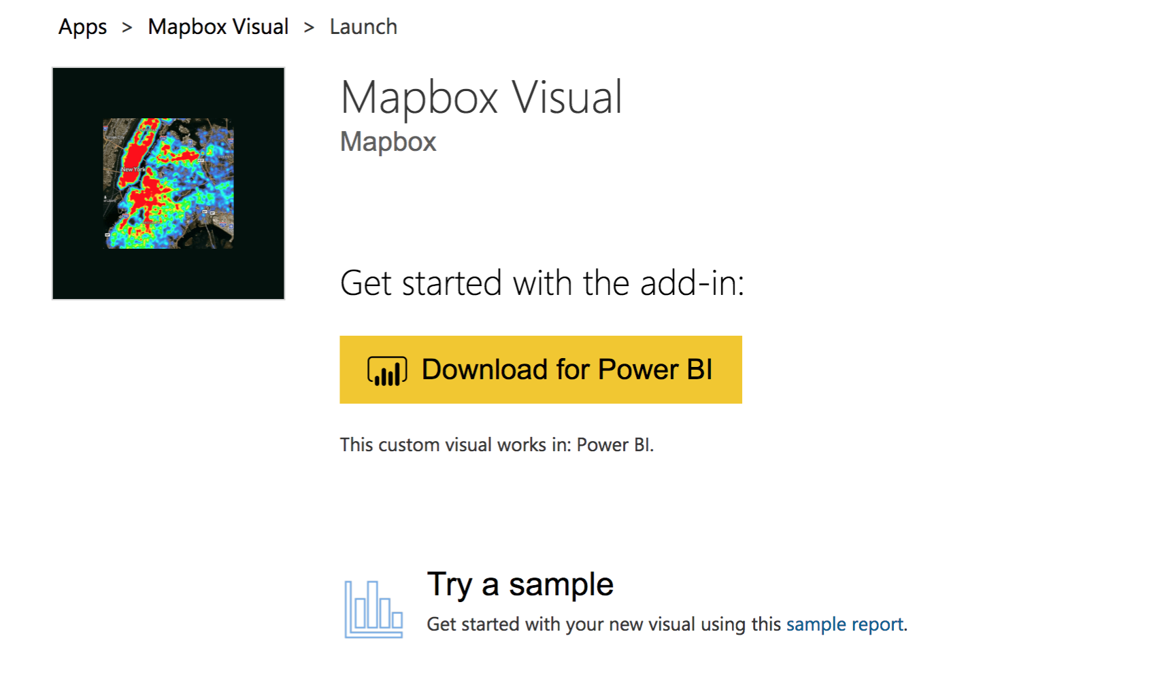
Geospatial in Powerbi
Mapbox
I love
Heatmap
Cluster
Map backgrounds e.g traffic info
I want
List of point of interest (POI)
Travel time from A to B

Slide 7
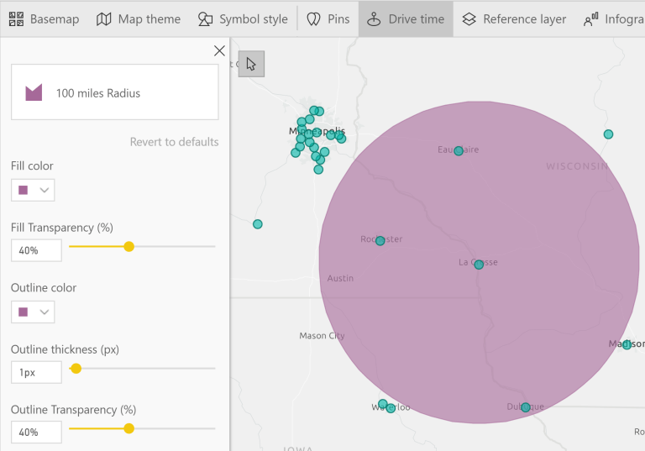
Geospatial in Powerbi
ArcGIS
I love
Driving time
Different map layers
Use atlas reference layers e.g Census data
I want
Tabular data for analysis
Free up to 1,000 points
source: https://dataveld.com/2019/03/20/display-points-within-a-distance-radius-on-a-power-bi-map/

Slide 8
What is OpenStreetMap (OSM) ?
OpenStreetMap is a free, editable map of the whole world that is being built by volunteers largely from scratch and released with an open-content license.

Slide 9
What I am going to cover
Find Points of interest from OpenStreetMap(OSM) database
Identify travel path between points
Geo-coding to get latitude / longitude
Explore other geospatial packages

Slide 10
What I am not going to cover
Introduction to R - R for Data Science Book https://r4ds.had.co.nz
OpenStreetMap Wiki - https://wiki.openstreetmap.org/wiki/Map_Features
Overpass Turbo API - https://wiki.openstreetmap.org/wiki/Overpass_API

Slide 11
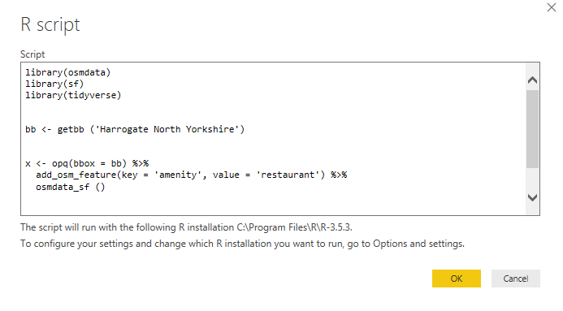
Point of Interest (POI)
“I need a list of POI (for this scenario - just restaurants) in Harrogate North Yorkshire UK and I want it to be in a table format and load it into Power Query. I don’t have access to on premise GIS system”
Notes:
Osmdata package downloads OSM data which is extracted from the 'Overpass' web server and processed with very fast 'C++' routines.
So this syntax - could be daunting - where did I get amenity from? Visit Map Features for reference.

Slide 12
OSMData
Download OSM data extracted from the 'Overpass' web server
library(osmdata) ## step 1 - load OSMData library (assuming that its already installed)
getbb ("Harrogate North Yorkshire") ## step 2 - set boundary box
## step 3 - build a query string to pass over to Overpass API
## key - look this up from openstreetmap wiki or check out overpass turbo for web
## interface http://overpass-turbo.eu
q <- opq ("Harrogate North Yorkshire") %>%
add_osm_feature(key = "amenity", value = "restaurant") %>%
osmdata_sf()
x = as.data.frame(q$osm_points) # load osm_points data frame into Power Query

Slide 13
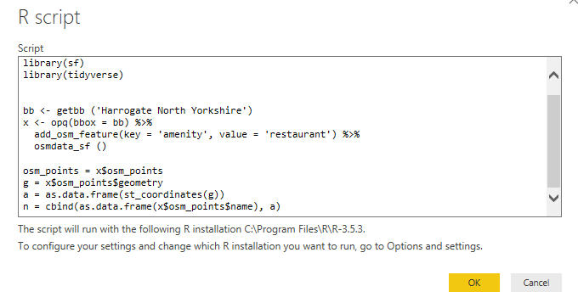
2. Geo-coding lat + long
“I want to use lat and lon data to do other cool stuff in Power Query”

Slide 14
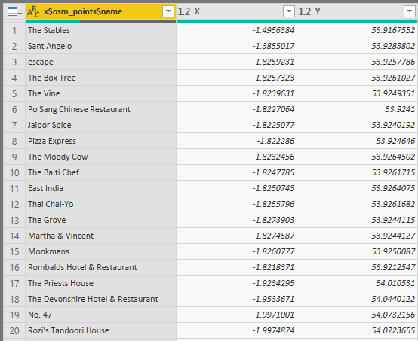
sf - simple features
Package “sf” provides simple features for data.frame with a geometry list-column
library(sf) ##load library
g = x$osm_points
a = st_coordinates(x$geometry)

Slide 15
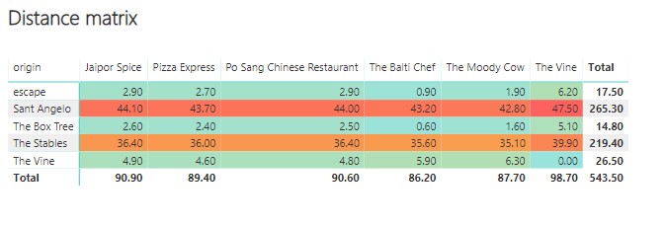
3. Travel path between points
“Where shall we meet for dinner?”
Notes:
The osrm package is an interface between R and the OSRM API. OSRM is a navigation service based on OpenStreetMap data.

Slide 16
OSRM
The osrm package is an interface between R and the OSRM API. OSRM is a navigation service based on OpenStreetMap data.
library(osrm) #load library
# Travel time matrix in small cut of data
# comparing rows 1-5 with rows 6-10
distA2 <- osrmTable(src = dataset[1:5,c("id","lon","lat")],
dst = dataset[5:10,c("id","lon","lat")])
#the above object is in matrix, so the below changes it to data.table for PowerBI
y = as.data.frame(as.table(distA2$durations))

Slide 17
Summary
A few of many useful R packages
OSRM - Interface Between R and the OpenStreetMap-Based Routing Service
OSMData - Download OSM data extracted from the 'Overpass' web server and processed with very fast 'C++' routines
sf - simple features for geometry list column

Slide 18
Recommended reading
Geospatial in R
Robin Lovelace - https://geocompr.robinlovelace.net
Jesse Sadler - https://www.jessesadler.com/post/geocoding-with-r/
PowerBI
Steph Locke - how to build interactive map R custom visual video https://www.youtube.com/watch?v=_zd-UGfD2Os
David Elderveld - display points within a distance radius on a Power BI map
https://dataveld.com/2019/03/20/display-points-within-a-distance-radius-on-a-power-bi-map/
Other
Overpass Turbo http://overpass-turbo.eu

Slide 19
Thank you!!!

